Slide 1
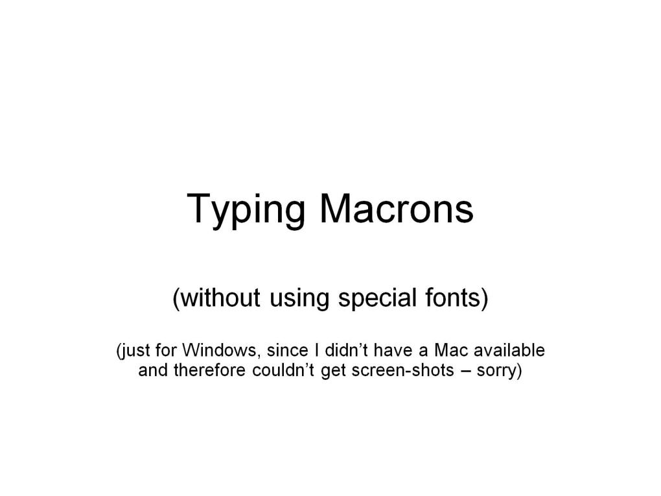
Typing Macrons

Slide 2
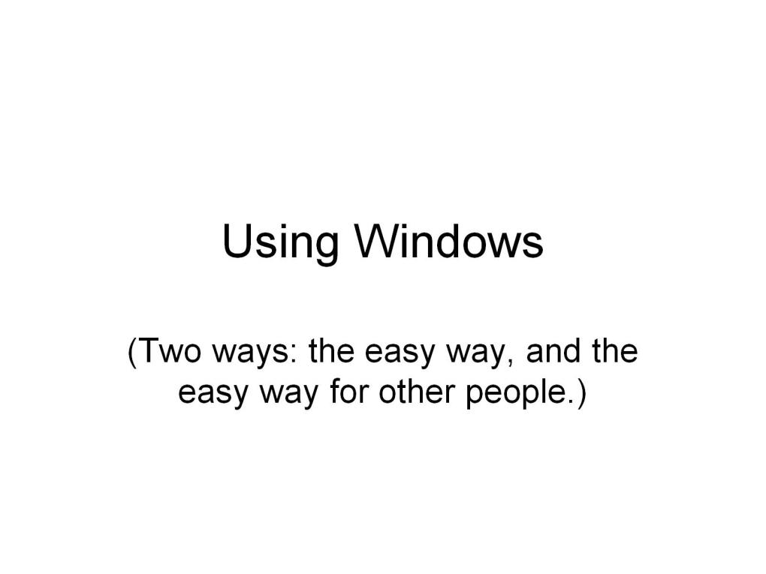
Using Windows

Slide 3
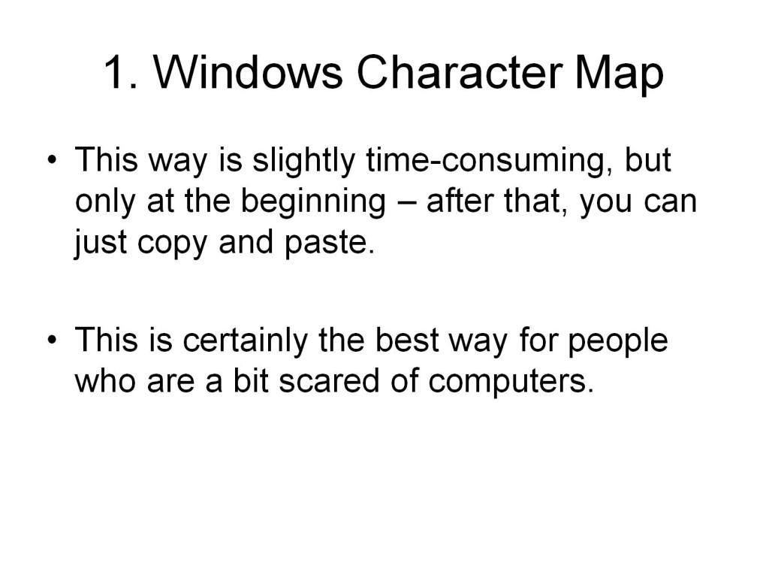
1. Windows Character Map

Slide 4
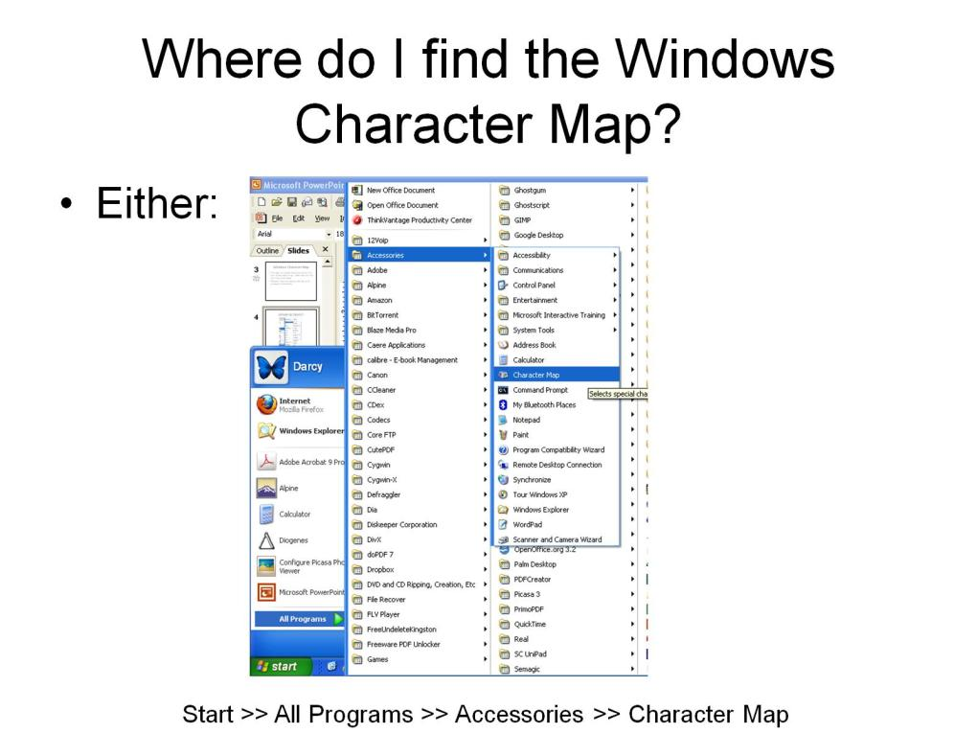
Where do I find the Windows Character Map?

Slide 5
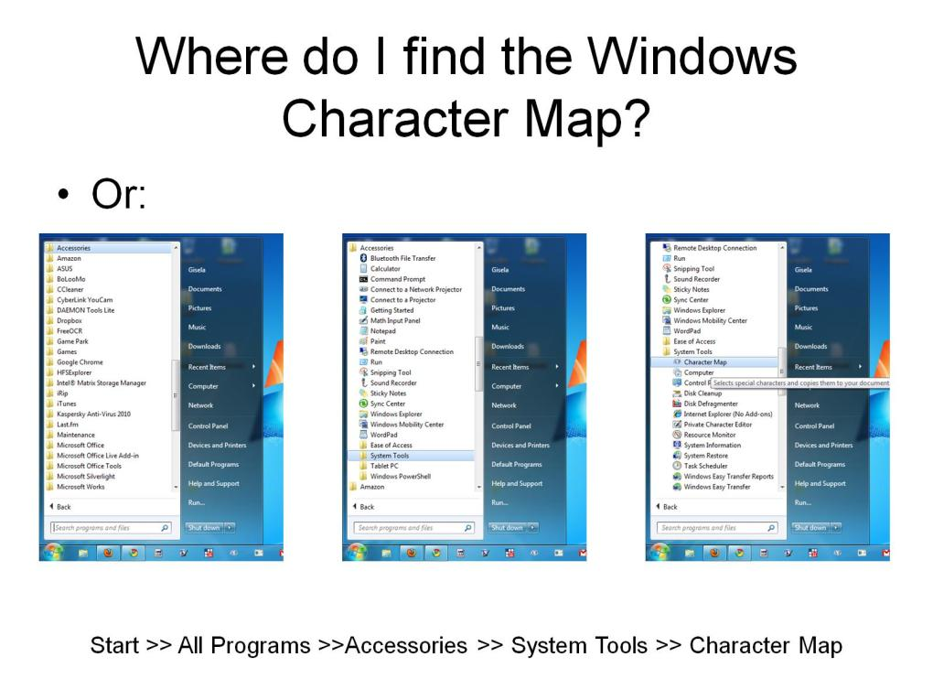
Where do I find the Windows Character Map?

Slide 6
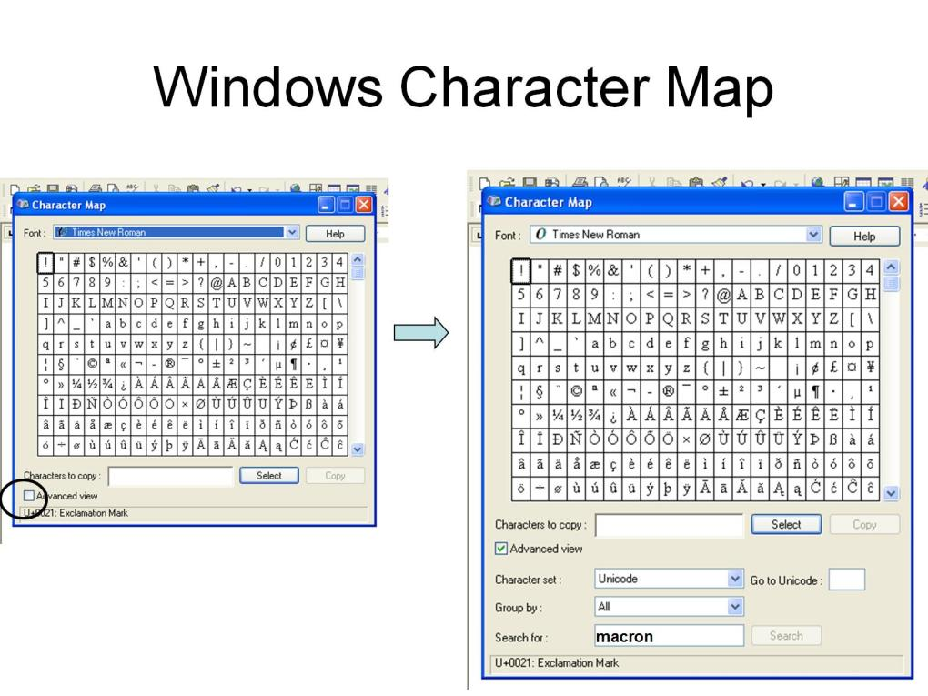
Windows Character Map

Slide 7
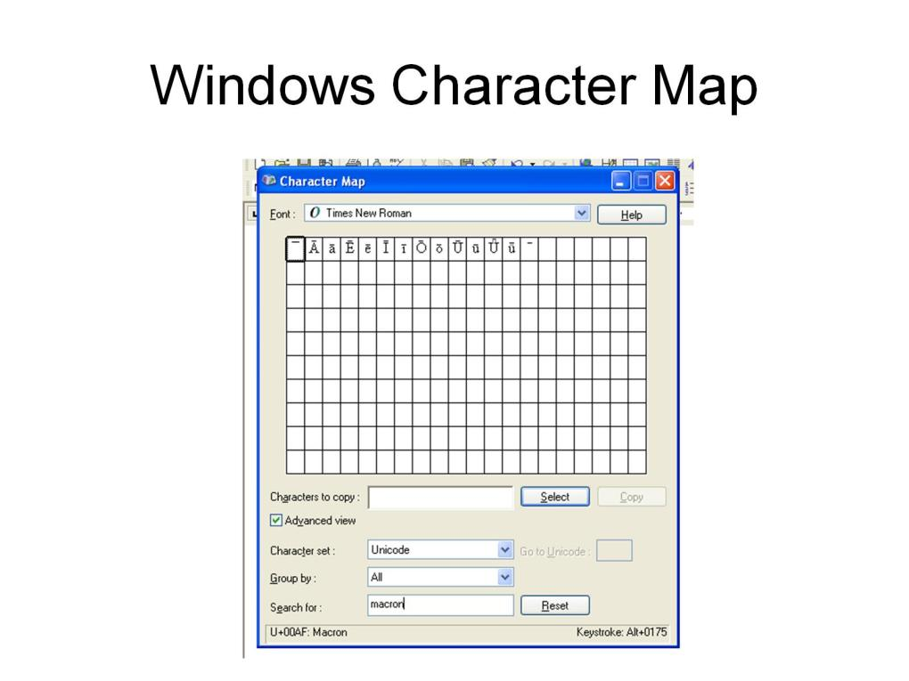
Windows Character Map

Slide 8
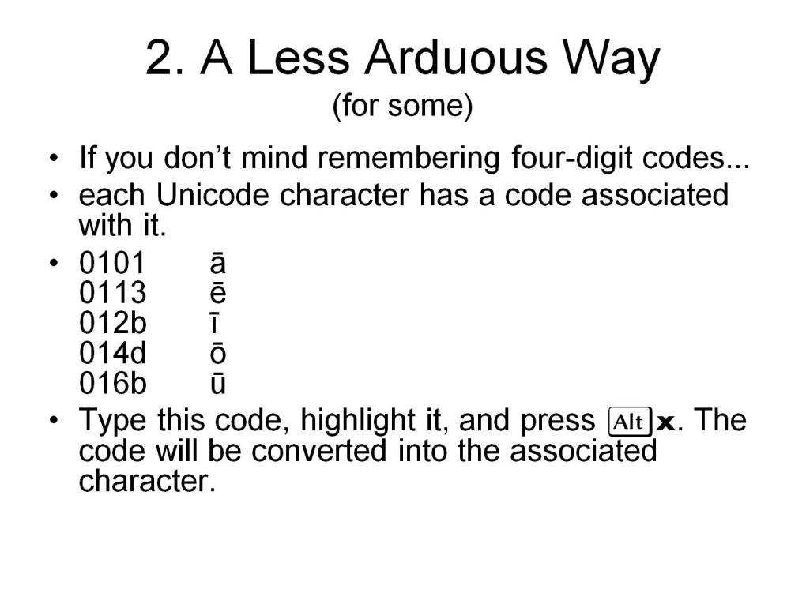
2. A Less Arduous Way (for some)

Slide 9
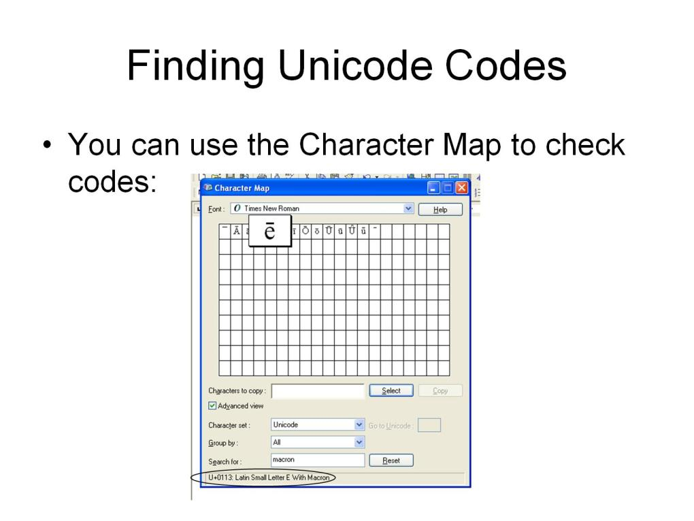
Finding Unicode Codes

Slide 10
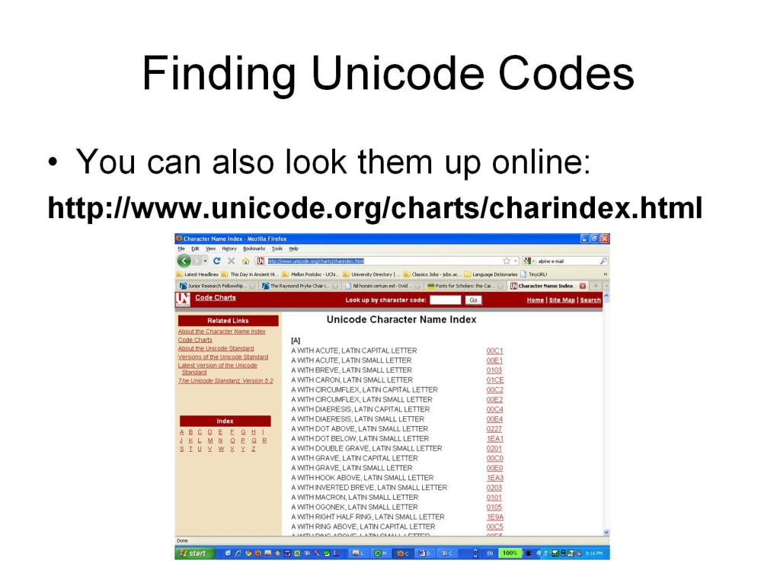
Finding Unicode Codes

Slide 11
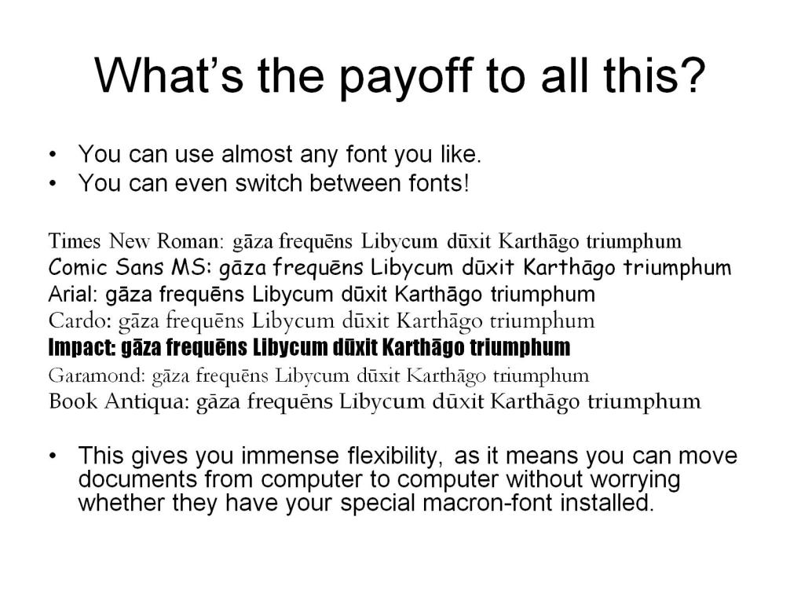
What’s the payoff to all this?

Slide 12
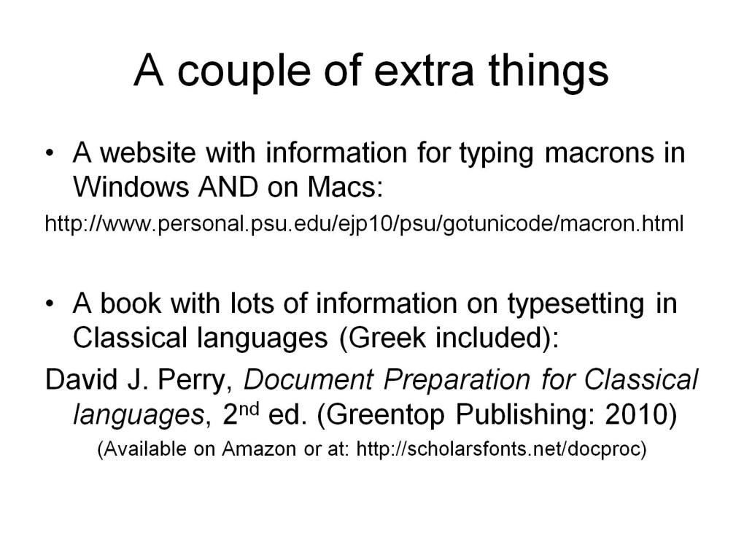
A couple of extra things

Slide 13
